Slide 1

Developing a Framework for SO/AC Reviews
Presenter: Rob Hoggarth

Slide 2

Why A New Framework?
Transparency & Fairness
Process Efficiency & Consistency
Organizational Effectiveness
Objectivity ...where possible
Notes:
After the “why,” I would present the “what,” i.e., overall review construct of Macro and Micro elements followed by the process/cycle.

Slide 3
Organizational Review Cycle
Review
16 Months
Implement
18 Months
Operations
30 Months
Assess
8 Months
New TOR
4 Months
5 Year
Cycle Start

Slide 4

Review Activities
Time | Activity | Macro | Micro
2 m | Selection | Review Committee | Consultant
8 m | Review | Primarily Interviews | Primarily Audit
2 m | Org Response | Clarification | Clarification
2 m | Public Comment | Remarks | Remarks
2 m | Implementation Plan | Develop | Develop
Review
16 Months
Implement
18 Months
Operations
30 Months
Assess
8 Months
New TOR
4 Months
5 Year
Cycle Start

Slide 5



Organizational Review Process
Five Year Cycle-Complete
MACRO
Qualitative Review:
Community Team
Contract & Team Selection
Conduct Review
Response & Comment
Plan & Implement
Operations
Assess
Revise Criteria
MICRO
Quantitative Review:
External Consultant
Notes:
This slide is a replacement for #5 if you would prefer the block format vs. text. It contains most of the steps, the durations, and shows how the Macro/Micro evals would be assigned.

Slide 6


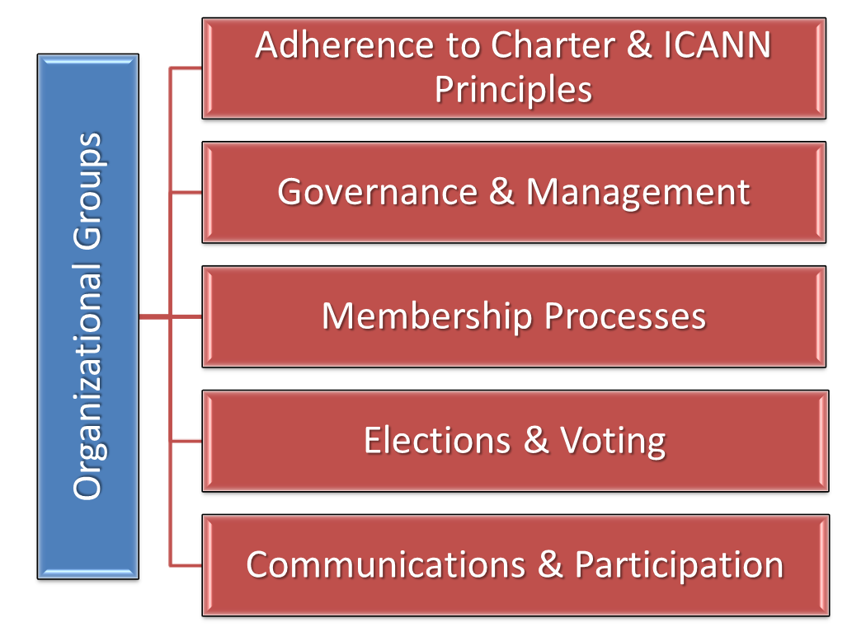
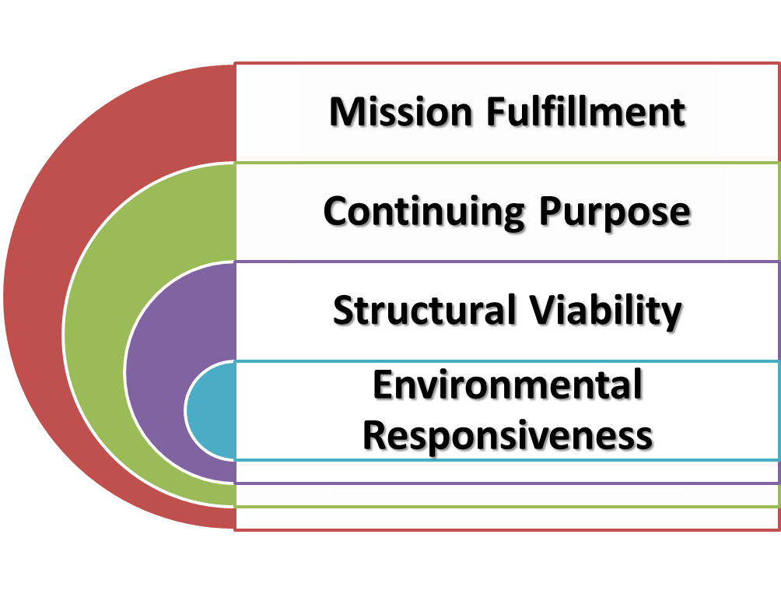
A Two Pronged Approach
Macro Elements
Qualitative
Micro Elements
Quantitative
Notes:
A Two Pronged Approach:
Macro focusing on qualitative elements
Micro focusing on measurable elements

Slide 7
Macro Elements: Qualitative
Mission Fulfillment
Structural Viability
Environmental Responsiveness
Continuing Purpose
Notes:
Macro (overall mission/purpose – qualitative)

Slide 8
Macro Criteria-GNSO (§1)
Section 1: Purpose (Evaluative Questions)
Has the SO been effective in achieving its principle mission as defined in its Charter or Bylaws?
Are there any internal/external factors that have contributed to or inhibited the achievement of SO's mission?
Have the SO's initiatives remained consonant with its mission and purpose?
Does the SO have a continuing purpose in the ICANN structure?
Does the mission/purpose of this SO need to be revised or amended in any way that would enhance its effectiveness within ICANN?
Has the SO been effective in achieving its key objectives/goals during the review period?
Notes:
For SG/Cs, Staff has identified 8 major operational components to be evaluated each with its own individual criteria or standards. These are broad evaluative questions that in the past we asked by the independent contracted reviewer.
Re objectives and goals, if an SO has not published a set of goals/objectives nor is that part of its standard process, the Review Team could deduce several objectives from actual initiatives that occurred. Alternatively, perhaps the SO’s should be asked to outline its major goals/objectives on an annual basis.

Slide 9
Macro Criteria-GNSO (§2)
Section 2: Structure (Evaluative Questions)
Is the SO organized in a way that supports and contributes to the achievement of its mission/purpose?
Are there any recommended structural/design changes or adaptations that would enhance the effectiveness of the SO in achieving its purpose?
Does the SO have the appropriate quantity and type of resources (human and financial capital) needed to accomplish its mission?
Are there any structural impediments affecting the SO from achieving its mission/purpose?
Macro Assessment
The Community Team should provide a brief summary statement as to the effectiveness of the organization's Purpose/Structure as a result of having explored the evaluative questions. Recommendations should be documented along with supporting rationale.
Notes:
For SG/Cs, Staff identified 8 major operational components to be evaluated each with its own individual criteria or standards

Slide 10
Micro Elements: Quantitative
Organizational Groups
Adherence to Charter & ICANN Principles
Governance & Management
Membership Processes
Communications & Participation
Elections & Voting
Notes:
Micro elements focus on the organization’s groups and how well they adhere to operational rules, practices, and principles.

Slide 11

Started With GNSO...
Council
SG/Cs
Working Groups
GNSO
Notes:
Staff started with the GNSO SG/Cs although we should also review the Council and Working Groups (greyed out-TBD)

Slide 12
Criteria for SG/Cs
Operational Components
1.0 Charter
2.0 Structure and Organization
3.0 Leadership and Management
4.0 Membership
5.0 Communications
6.0 Elections and Voting
7.0 Finance, Accounting, and Records
8.0 Participation and Engagement
We have prepared an example from this component
Each one separately evaluated according to specific criteria...
Notes:
For SG/Cs, we identified 8 major operational components to be evaluated each with its own individual criteria or standards

Slide 13

Objectivity
Point-Based Rating Scale
Rating: | 1 | 2 | 3 | 4 | 5
Score: | 0-20 | 21-40 | 41-60 | 61-80 | 81-100
Meaning: | Almost Never | Occasionally | Frequently | Often | Almost Always
Next: How it could be applied...
Notes:
To achieve objectivity, Staff developed a five-point rating scale with 20 point spreads corresponding to the frequency that the organization meets a specific objective criterion

Slide 14

Example
From Section 5.0 Communications
No. | Tag | Y/N | Note | Criterion
1 | O | N |  | Does the organization publish a calendar containing events with dates/times?
2 | O | Y |  | Percentage of Open (i.e., not Closed) leadership meetings to Total > 90%
 |  |  |  | Based upon a random sample of organization meetings and teleconferences held within the past 12 months:
3 | O | N |  | - Notifications to invitees were sent out at least 7 days in advance > 90% of the time
4 | A | Y |  | - A record of the meetings (e.g., summary, key decisions, action items) was published within 14 days > 90% of the time
5 | T | Y |  | Does the organization have a web or wiki presence?
6 | T | N |  | A record of all meetings (see above definition) is made available on the organization's web or wiki site.
7 | O | Y |  | Does the organization maintain an archived public e-mail distribution list?
Rating | Tag | Applicable Criteria | Number of Ys | Percent (Score)
3 | (*) | 7 | 4 | 57
ICANN Principles (Tag): F=Fairness; O=Openness; R=Representativeness;
T=Transparency; and A=Accountability.
Notes:
Step 1: Evaluate each of the seven (7) criteria as Y or N [click mouse for fly-in]
Step 2: Take the number of Ys (4) divided by the total number of criteria (7) to develop a score (57%)
Step 3: look up the score in the rating table (57 corresponds to a 3 or “Frequently” meets the standards)

Slide 15
Overall Assessment?
Aggregate
Average (*) 8 component scores to yield single overall composite rating
Individualize
No total score, but require an action plan for any individual component rating < 4.0
Option 1
Option 2
(*) Could also be a weighted average

Slide 16
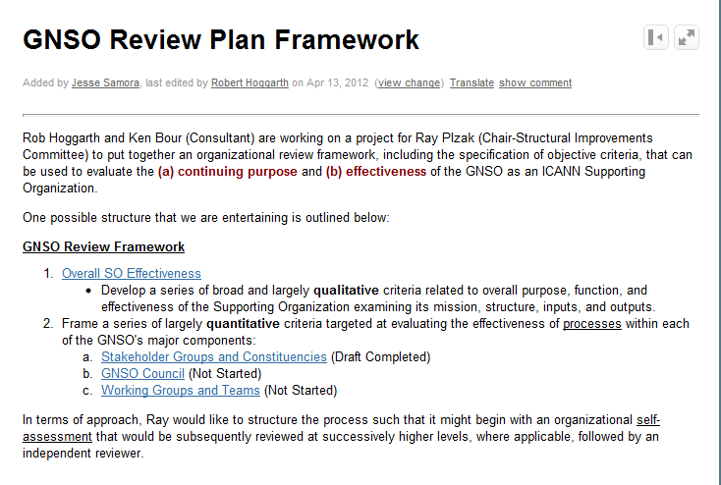

GNSO Development on Wiki
Work-in-Progress at this Wiki link:
https://community.icann.org/display/GNSO/GNSO+Review+Plan+Framework

