Slide 1
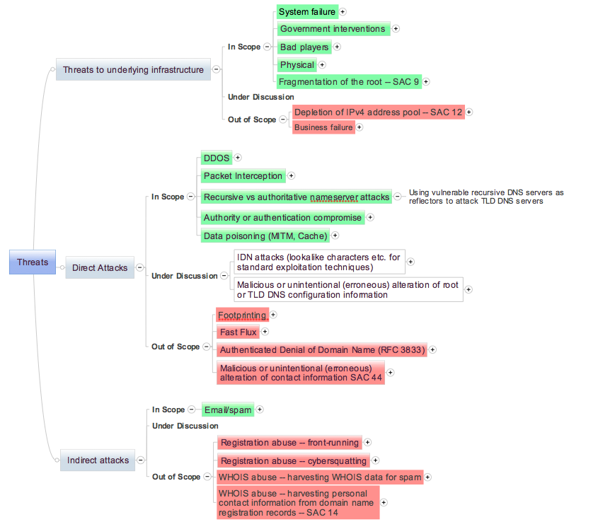
DSSA Membership
At Large Members
Edmon Chung
Olivier Crépin-Leblond (co-chair)
Mohamed El Bashir
Cheryl Langdon-Orr
John R. Levine
Andre Thompson
Patrick Vande Walle
ccNSO Members
Roy Arends, .uk
Sean Copeland, .vi
Wim Degezelle, CENTR
Luis Diego Espinoza, .cr
Mark Elkins, .za
Ondrej Filip, .cz
Jaques Latour, .ca
Otmar Lendl, .at
Takayasu Matsuura, .jp
Katrina Sataki, .lv
Jörg Schweiger, .de (co-chair)
Sean Shen, .cn
Chris Wright, .au
GNSO Members
Greg Aaron – (RySG)
George Asare-Sakyi – (NCSG)
Don Blumenthal – (RySG)
Rafik Dammak – (NCSG)
Keith Drazek – (RySG)
Rossella Mattioli – (NCSG)
Scott McCormick – (CBUC)
Mikey O'Connor – (CBUC) (co-chair)
Adam Palmer – (CBUC)
Forest Rosen – (RrSG)
Matt Serlin -- (RrSG)
Rick Wilhelm – (RrSG)
NRO Members
Andrew de la Haye (RIPE NCC)
Byron Ellacott (APNIC)
Nishal Goburdhan (AFRINIC)
Mark Kosters (ARIN) (co-chair)
Carlos Martinez (LACNIC)
George Michaelson (APNIC)
Subramanian Moonesamy (AFRINIC)
Wolfgang Nagele (RIPE NCC)
Arturo Servin (LACNIC)
Pete Toscano (ARIN)
SSAC
Patrik Fältström, Cisco (SSAC Chair)
Jim Galvin, Afilias (SSAC Vice Chair)(co-chair)
KC Claffy, CAIDA
David Conrad
Matt Larson, VeriSign
Rick Wesson, Support Intelligence Inc.
Rick Wilhelm, Network Solutions
Experts
Bill Manning
ICANN Support Staff
Bart Boswinkel
Gisella Gruber-White
Julie Hedlund
Patrick Jones
Kristina Nordstrom
David Olive
Glen de Saint Géry
Gabriella Schittek
Threats (Draft – for discussion)
DSSA
Joint DNS Security and Stability Analysis Working Group
Sponsored by: At-Large, ccNSO, gNSO, NRO, and SSAC
CONTACT US:
We’re interested in your thoughts
Post a comment on our wiki: community.icann.org (look in the “cross community” area)
Email – any of our members

Slide 2
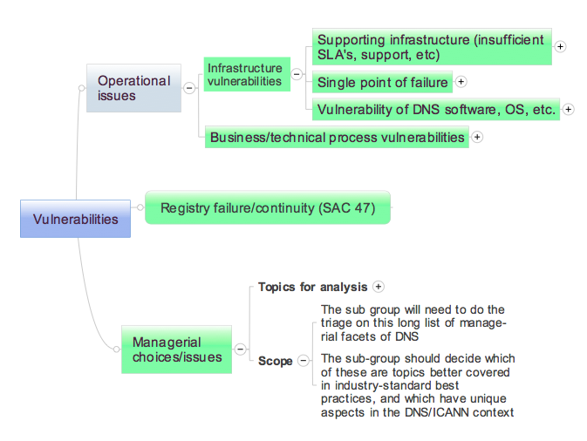
DSSA Membership
At Large Members
Edmon Chung
Olivier Crépin-Leblond (co-chair)
Mohamed El Bashir
Cheryl Langdon-Orr
John R. Levine
Andre Thompson
Patrick Vande Walle
ccNSO Members
Roy Arends, .uk
Sean Copeland, .vi
Wim Degezelle, CENTR
Luis Diego Espinoza, .cr
Mark Elkins, .za
Ondrej Filip, .cz
Jaques Latour, .ca
Otmar Lendl, .at
Takayasu Matsuura, .jp
Katrina Sataki, .lv
Jörg Schweiger, .de (co-chair)
Sean Shen, .cn
Chris Wright, .au
GNSO Members
Greg Aaron – (RySG)
George Asare-Sakyi – (NCSG)
Don Blumenthal – (RySG)
Rafik Dammak – (NCSG)
Keith Drazek – (RySG)
Rossella Mattioli – (NCSG)
Scott McCormick – (CBUC)
Mikey O'Connor – (CBUC) (co-chair)
Adam Palmer – (CBUC)
Forest Rosen – (RrSG)
Matt Serlin -- (RrSG)
Rick Wilhelm – (RrSG)
NRO Members
Andrew de la Haye (RIPE NCC)
Byron Ellacott (APNIC)
Nishal Goburdhan (AFRINIC)
Mark Kosters (ARIN) (co-chair)
Carlos Martinez (LACNIC)
George Michaelson (APNIC)
Subramanian Moonesamy (AFRINIC)
Wolfgang Nagele (RIPE NCC)
Arturo Servin (LACNIC)
Pete Toscano (ARIN)
SSAC
Patrik Fältström, Cisco (SSAC Chair)
Jim Galvin, Afilias (SSAC Vice Chair)(co-chair)
KC Claffy, CAIDA
David Conrad
Matt Larson, VeriSign
Rick Wesson, Support Intelligence Inc.
Rick Wilhelm, Network Solutions
Experts
Bill Manning
ICANN Support Staff
Bart Boswinkel
Gisella Gruber-White
Julie Hedlund
Patrick Jones
Kristina Nordstrom
David Olive
Glen de Saint Géry
Gabriella Schittek
Vulnerabilities (Draft – for discussion)
DSSA
Joint DNS Security and Stability Analysis Working Group
Sponsored by: At-Large, ccNSO, gNSO, NRO, and SSAC
CONTACT US:
We’re interested in your thoughts
Post a comment on our wiki: community.icann.org (look in the “cross community” area)
Email – any of our members

