Slide 1
OVERVIEW
“Policy Update IGO/INGO PDP” 11.00 – 12.30 on Wednesday, 17 July in Hall 6
This session has two goals:
Raise awareness of why this issue is important and provide transparency on WG deliberations/contrasting positions to date
Facilitate an interactive discussion and solicit new ideas from the community on key outstanding issues to help guide WG moving forward
Agenda
Time | Activity
:05 min | Welcome/introductions
:15 min | Description of activities/goals & presentation of topics and associated propositions
:12 min | Gallery walk input time #1, then rotate
:12 min | Gallery walk input time #2, then rotate
:12 min | Gallery walk input time #3, then rotate
:12 min | Gallery walk input time #4, then return to seats
:20 min | Readout of key ideas generated at each position (~5 min / topic)

Slide 2
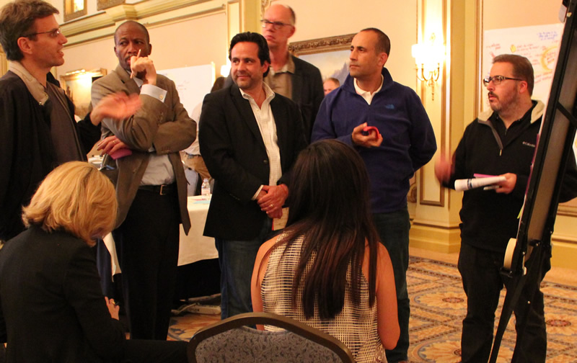
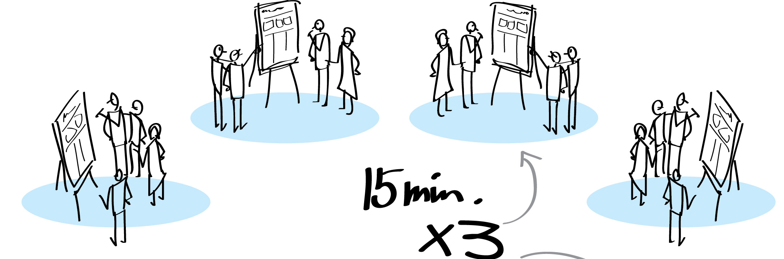
THE EXERCISE
In our Gallery Walk exercise, participants will cycle through each of four locations in the room spending :12 minutes at each to discuss and provide their input on a topic there.
While participants will move, each location will be “staffed” by two people throughout:
A subject matter expert for that topic to prompt and answer questions
A facilitator to help prompt input and ensure collection of ideas
Topic B
Topic C
Topic A
Topic D

Slide 3
TOPIC A
Should the identifiers of IGOs & INGOs be protected at the top and/or second level?
Proposition A | Protections should be provided to identifiers of qualifying INGOs
Proposition B | Protections should not be provided to INGOs other than the RCRC and IOC
Proposition C | Protections should be provided to identifiers of INGOs other than the RCRC & IOC
Proposition D | Protections should not be provided to any IGOs or INGOs
Other ideas or suggestions?

Slide 4
TOPIC B
If protections are provided through a Reserved Names List, should there be an exception process to allow the relevant organization and/or a legitimate right holder to register the identifier at the top and/or second level?
Proposition A | Exception Option #1
Proposition B | Exception Option #2
Proposition C | No exception procedures
Other ideas or suggestions?

Slide 5
TOPIC C
Should organization acronyms be protected at the top and/or second level?
Proposition A | Protection from registration
Proposition B | Use of a Clearinghouse Model and/or existing RPMs
Proposition C | No protections
Other ideas or suggestions?

Slide 6
TOPIC D
What should be the objective set of criteria to determine whether an organization should receive special protections?
Proposition A | Matrix Recommendation #1 – RCRC/IOC
Proposition B | Matrix Recommendation #2 – IGOs
Proposition C | Matrix Recommendation #3 – INGOs
Other ideas or suggestions?

Slide 7
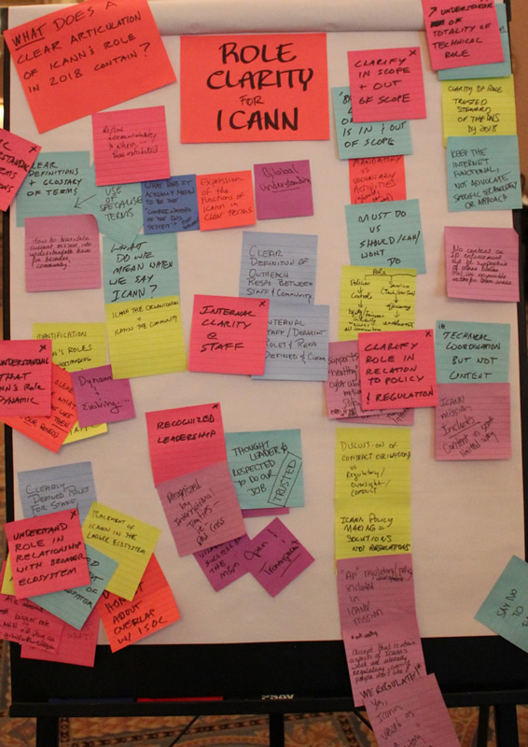
OUTPUTS
XPLANE to provide high-resolution photos of notes collected as a digital archive
ICANN to take the physical feedback (posters)
ICANN option to provide write-up of the feedback collected to the community
Example poster of feedback collected on a topic from an earlier ICANN workshop.

