Slide 1
JAS WG Final Report Supporting Applicants from Developing Economies
September 2011
Presenters: Avri Doria; Alan Greenberg

Slide 2
Agenda
Terminology Clarification
Why provide support?
Activities timeline
Final Report structure
Final Report highlights
Next steps

Slide 3
Clarification Terminology
Developing Economies Support Program (DESP)
Support Application Review Panel (SARP)
Support Eligibility Criteria
Support Evaluation Process
Support Candidate (SC)
Support-Approved Candidate (SAC)
Support Recipient

Slide 4
Why Provide New Applicant Support? Highlights
June 2008 - New gTLD Policy IG-N:
“ICANN may put in place a fee reduction scheme
for gTLD applicants from economies
classified by the UN as least developed.”
March 2010 - Nairobi Board Resolution # 20:
“to develop a sustainable approach to providing support to applicants requiring assistance in applying for and
operating new gTLDs”
February 2011 on - GAC support on fee reduction (scorecard)

Slide 5
JAS WG Activities Timeline 2010
Jun 23 - ICANN Brussels Meeting “Reducing Barriers to New gTLD Creation in Developing Regions”
Dec 9 - ICANN Cartagena Meeting “Assisting Applicants from Developing Economies”
Sept 25 Board Resolution #2.2 – no fee reduction
Mar 13 Board Resolution #20
Oct 28 Board Resolution #12
Apr 1 GNSO & ALAC
Motion to create
Joint SO/AC WG
On going bi-weekly conference calls….
Mar 10 GAC Letter to
ICANN
Apr 29 Joint
SO/AC WG
formed
Jun 14 blog
“Call for Input: Support for
New gTLD Applicants”
Jun 16 - Aug 23 posted “Support Snapshot” for
Public Comment
Sep 18 - Excerpt Prepared for Special Meeting of ICANN Board
Nov 11 – Publications:
Milestone Report, Addenda; Summary & Analysis
Request for Charter Extension!
Notes:
Milestone report – Very specific on the level of support for each of the recommendations. Most have full Consensus
Translation into 6 UN Languages coming soon.

Slide 6
JAS WG Activities Timeline 2011
Mar - ICANN San Francisco Meeting – no public session only WG meeting
Sep
Final Report ready for GNSO, ALAC and board reviews
Dec – Feb GNSO, ALAC
Charter renewal process
Jan resume conference calls, election of new chairs
May
Second Milestone Report (MR2)
Oct - ICANN Dakar Meeting
Public Session (details tbd)
On going bi-weekly conference calls….
Feb – on
GAC scorecard addresses applicant support and fee reductions
Feb - Mar posted Summary & Analysis Milestone Report 1 (6 UN languages)
Jun
Answers sent to GNSO, RYC questions
cost questions sent to staff
GNSO….
GAC/Board/JASWG conference call
Jun - ICANN Singapore Meeting
Board resolution on 2 Million seed money
“JAS WG proposal for support for New gTLD Applicants from Developing Countries”
Sep
Webinar to SOs/ACs
Notes:
Milestone report – Very specific on the level of support for each of the recommendations. Most have full Consensus
Translation into 6 UN Languages coming soon.

Slide 7
Final Milestone Report
When should support be provided?
Who should be approved to receive support (Support-Approved Candidate or SAC)?
How should a candidate for support (Support Candidate or SC) be evaluated?
What support specifically should be offered?
How should the overall support process work?
How should the support process relate to the gTLD Applicant Guidebook (AG) process?

Slide 8
When Should Support be Offered?
The full array of financial and non-financial support to be
offered to Support-Approved Candidates should be available in the first and all
subsequent rounds of new gTLD applications.
Why?
New gTLD Program should be inclusive
With every new gTLD application round, the market competitive disadvantage of under-served communities increases
There is no indication when there will be a second round and whether in subsequent rounds, fees will be reduced. In case there is any reduction, by how much
There is built-up demand for new gTLDs, including IDN gTLDs

Slide 9
Who Qualifies for Support?
Service to Public Interest + Financial capability & need
Operation in an emerging market or nation in a manner that provides genuine local social benefit
Support by and/or for distinct cultural, linguistic and ethnic communities
Sponsored by non-profit, civil society and non-governmental organizations in a manner consistent with the organizations' social service mission(s)
Service in an under-served language, the presence of which on the Internet has been limited
Operated by local entrepreneur, providing demonstrable social benefit in those geographic areas where market constraints make normal business operations more difficult

Slide 10
The Following Do NOT Receive Support
An applicant for a gTLD string that is intended to reference a specific commercial entity (commonly referred to within ICANN as a “dot-brand”);
A governmental or para-statal institution (BUT discussion with GAC continuing)
A gTLD string that is a geographic name or is based on one;
Affiliated with sponsors or partners that are bankrupt or under bankruptcy protection;
Affiliated with sponsors or partners that are the subject of litigation or criminal investigation;
Incapable of meeting any of the Applicant Guidebook’s due diligence procedures.

Slide 11
Service in Public Interest Clarification
Support by and/or for distinct cultural, linguistic or ethnic communities;
Service in an under-served language, the presence of which on the Internet has been limited;
Operation in a developing economy in a manner that provides genuine local social benefit;
Advocated by non-profit, civil society and non-governmental organizations in a manner consistent with the organizations’ social service mission(s); and
Operation by a local entrepreneur(s), providing demonstrable social benefit in those geographic areas where market constraints make normal business operations more difficult.

Slide 12
Fee Considerations
Primarily, a reduction of the application fee to USD47,000 from USD185,000 (as also suggested by GAC and ALAC);
The fee reduction is to be separate from the financial support based on the Board allocated $2m
The staggering of application fees (installment payments);
The relaxing or deferring of the upfront costs of the required “continuity instrument”; and
The possible creation of a development fund.

Slide 13
Fee Reduction and Cost Recovery
GNSO Implementation Guideline B: "Application fees will be designed to ensure that adequate resources exist to cover the total cost to administer the new gTLD process. Application fees may differ for applicants.“
Report suggests a number of ways that fee reduction can be funded without the $2m+ and without impacting operational cost-recovery
Depending on exact number of total new gTLD Applicants and support recipients, return to reserve of sunk costs may be reduced

Slide 14
More on Financial Support
The financial support should be funded via various sources, including the USD2 million allocated by the ICANN Board, solicited third parties and auction revenues.
The creation of a foundation to collect and distribute the financial support to Support Recipients should be investigated by a Board-appointed planning committee.
Support Recipients should be required to pay back financial support (not including any fee reductions) received, thereby helping to make the Support Program sustainable.

Slide 15
Foundation
Board set up a planning committee to:
Work with ICANN staff to investigate and understand the legal structures that are available to and required of ICANN, a California 501(c) corporation, for creating a foundation;
Draft a document defining the core responsibilities and activities of the fund or foundation;
Define methods of work for the fund or foundation, including, inter alia, investment guidelines, fundraising and grant making;
Suggest membership for the first board of the foundation and clarify the relationship between ICANN’s corporate structure and the new fund or foundation; and
Start obtaining pledges of funding for the foundation, to augment the USD2 million already committed by the ICANN Board at its Singapore meeting in Resolution 2011.06.20.01 WG members believe that the domicile of any prospective foundation should not be limited to the United States. There may be useful and valid practical reasons for creating a foundation in other countries or regions.

Slide 16
Funding Sources
Budget allocation from ICANN, including the USD2 million already committed by the ICANN Board;
Solicitation of funds to at least match the initial allocation made by the ICANN Board;
Auction proceeds beyond the cost of running the auctions;
Voluntary allocation of funds from ccTLDs;
Voluntary allocations of funds from incumbent gTLD registries and registrars;
External funding sources (e.g., grants from government or other inter-governmental organizations); and
Other sources yet to be determined

Slide 17
Use of Funds
Application assistance (beyond the JAS WG’s recommended reduction in fees);
The relaxing or deferring of the upfront costs of the required continuity instrument;
The possible creation of a development fund for Support-Approved Candidates;
The possible funding of proposals to create regional non-profit Registry Service Providers (RSP) to support multiple applicants for new gTLDs in developing economies
Overcoming technical requirement gaps, such as the IPv6 and other technical requirements, that may require technical upgrades not obtainable through the non-financial support offered to Support-Approved Candidates.

Slide 18
Non-Financial Support
Types of non-financial support should include but not be limited to:
Assistance with the preparation of gTLD applications;
Facilitation of IPv6 compliance;
Consulting and education regarding DNSSEC implementation;
Outreach and education efforts regarding the New gTLD Program;
Logistical, translation and technical support; and
Establishment of Registry Service Providers in regions where none or few exist.
ICANN should serve as a facilitator for this non-financial support by providing a clearinghouse function to assist Support-Approved Candidates and third-party donors in finding each other.

Slide 19
Eligibility Requirements
The specific support eligibility criteria should include:
A specific service to the public interest; and
Both a level of financial need and of financial capability.
Various criteria should disqualify a Support Candidate, such as the application for a gTLD string that is intended to reference a specific commercial entity (commonly referred to within ICANN as a “dot-brand”). However, applications for community names that may be subject to legal trademark protection are not necessarily disqualified from receiving support

Slide 20
Information/Documentation Required
All Candidates should be required to provide a self-declaration stating that they are eligible to receive support under the aforementioned criteria;
Annual reports or equivalent;
Evidence of any previously funded projects showing degree of success in meeting goals of the project;
Financial reports showing need;
Letters of reference regarding candidates ability to form a sustainable operation; and
Documentation showing evidence of all qualifying circumstances.

Slide 21
Support Evaluation Process at a Glance
The SEP should take place before the standard gTLD application review.
Each support application should be evaluated by a Support Application Review Panel (SARP). The SARP should be composed of volunteers from the ICANN community and outside experts, all with knowledge of the existing new gTLD processes, potential gaming patterns and the general needs and capabilities of Support Candidates from developing economies.
When the SARP rejects a Support Candidate, the SARP should explain its reasons. The Support Candidate may then work to improve its application and reapply for support or may apply for a gTLD without support.
Support Candidates are still responsible for paying the USD5,000 gTLD application deposit.
The ICANN Staff should produce a Support Candidate Guide.

Slide 22
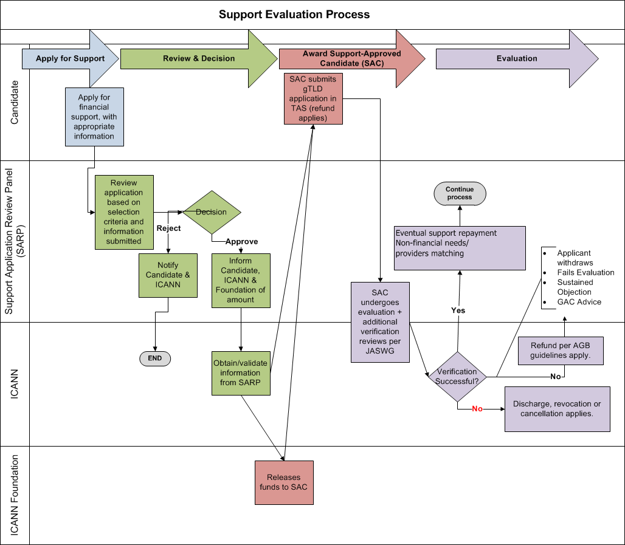

Slide 23
Next Steps
Consideration by GNSO, ALAC and THEN Board
Publication Final Milestone Report for public comment (in 6 UN languages)
ICANN Dakar meeting (Oct 23-28) public session with opportunity for Q&A (session with interpreters Spanish and French)
Publication of MR2 Comment Summary Analysis
Implementation by staff based on Board direction

Slide 24
Where to Find More Info…
Wiki:
https://community.icann.org/display/jaswg/JAS+Issues+and+Recommendations
New gTLD Program:
http://www.icann.org/en/topics/new-gtld-program.htm

