Slide 1
GNSO Review Webinar
7 May 2014

Slide 2
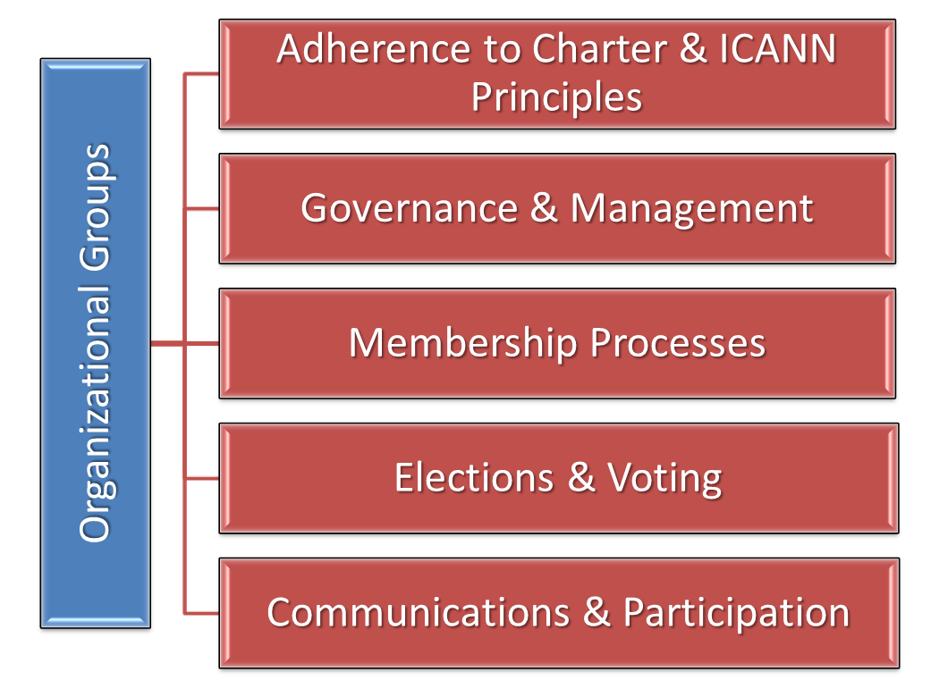
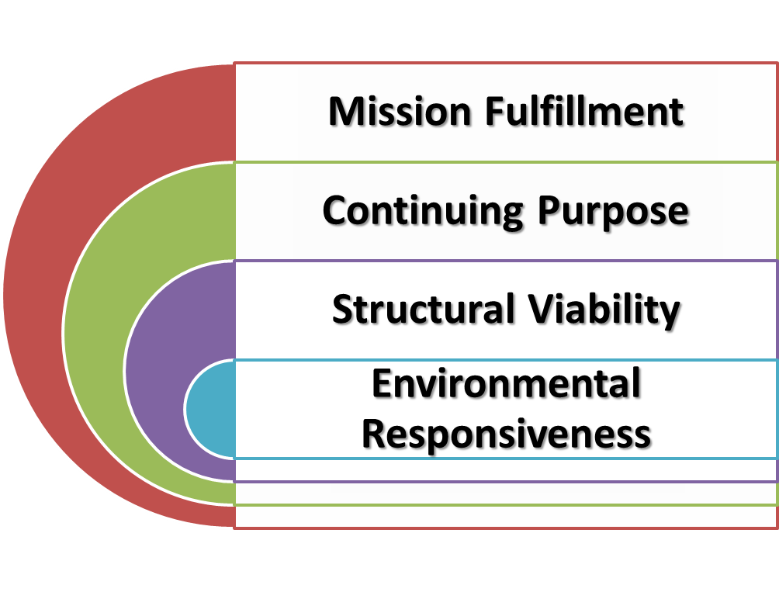
GNSO Review
Notes:
Introduction by Ray:
This review will be different in a variety of ways – focus on organizational effectiveness, use of objective and quantifiable criteria, GNSO involvement in the process, implementation.
GNSO Review, piloting various new concepts, will inform the work on evolving the Review Framework.
Ensure the Accountability and Transparency of ICANN Organizations and their Processes - using measures and mechanisms to maintain public confidence in viability, reliability, and accountability of ICANN

Slide 3
Overview
ICANN’s commitment to continuous improvement based on Bylaws requirement for regular reviews of structures.
Involvement of the GNSO and broader community – important components.
Opportunity for GNSO community to suggest and introduce change to improve effectiveness.
Incorporation of “self-review” and direct involvement in the review process.
Performed by an independent examiner selected through a competitive bidding process.
Expected start date on or about 1 July 2014.
Focus on useful recommendations and manageable implementation plans and efforts.

Slide 4
Review Objective
Examine organizational effectiveness
Independent Examiner (IE)
Tightly scoped contract
Selected by competitive bid – 10 responders
Work Methods
360 Assessment [Staff, GNSO]
Examine documentation, records, reports [IE]
Integrate ATRT2 assessments [IE]
Limited interviews [IE]
Criteria
Objective and quantifiable
Selected from developed lists
Used for examination, 360 Assessment, and interviews
Notes:
360 Assessment – Jen

Slide 5
Timeline
Phase | Date | Activities
Pre-Review | MAR ‘14 – JUN ‘14 | Finalize Plan Prepare 360 RFP/Select Examiner
Review | JUL ‘14 – FEB ‘15 | Conduct Review Report and Recommendations Implementation Plan
Implement | MAR ‘15 – FEB ‘16 | Corrective Action Integrate into Plans and Budget Publish Implementation Report and Updates Monitor Implementation
Operate | MAR ‘16 – MAR ’18 | Gain Operational Experience
Assess | APR ‘18 – DEC ‘18 | Conduct Effectiveness Self-Assessment Prepare Report for Next Review

Slide 6
Review Process
Review
Review ATRT 2 Assessments
Report
Draft Report 2
Implement
360 Assessment
Public comments
Board Approval
Board Accept
Interviews
Examination
Draft Report 1
Clarification and Rebuttal
Prepare and Coordinate Implementation Plan
Final Report
Implementation

Slide 7
Roles and Responsibilities
SIC
Oversight
Accept report*
Staff
Design 360
Examiner
Examination
360 assessment
Review Working Party
Coordinate 360
Coordinate interviews
Approve plans*
Select examiner
Prepare Implementation Plan
Manage report process
Interviews
Integrate ATRT2 Recommendations
Prepare Report
Clarification and rebuttal
Support review
Clarification and rebuttal
Prepare Implementation Plan
Monitor process
Prepare RFP
Refine criteria
Feedback on criteria
*Prepare Recommendations for Board Action
Notes:
Jen – update on the formation of the GNSO Review Working Party

Slide 8
Thank you! Questions?

Slide 9
Social Media
https://twitter.com/ICANN
http://gplus.to/icann
https://www.facebook.com/icannorg
http://weibo.com/icannorg
http://www.linkedin.com/company/icann

