Slide 1
JIG (Joint ccNSO-GNSO IDN Working Group) Meeting
ICANN Buenos Aires
November 18, 2013

Slide 2
Agenda
Next Steps
Universal Acceptance of IDN TLDs
IDN Variant TLDs
Single Character IDN TLDs
Future Works
Form / Approach / …

Slide 3
Background of the JIG
Charter adopted by both the ccNSO and GNSO Councils:
http://ccnso.icann.org/workinggroups/jiwg.htm
The purpose of the JIG is to identify and explore issues and topics of common interest of relevance to both the ccNSO and GNSO and report on such an identified issues to the respective Councils and propose methodologies to address the issues

Slide 4
JIG Discussions
Bi-Weekly Conference Calls (since March 2010)
Changed to Monthly Calls (since Prague: June 2012)
Issues of Common Interest identified:
Single Character IDN TLDs
IDN TLD Variants
Universal Acceptance of IDN TLDs
Face to face meetings
Brussels / Cartagena / San Francisco / Singapore / Dakar / Costa Rica / Prague / Toronto / Beijing / Durban / BA
Workshop on Single Character IDN TLD at Cartagena
Workshop on Universal Acceptance of IDN TLDs in Beijing

Slide 5
Universal Acceptance of IDN TLDs
Initial Report Published Jan 6, 2012
Draft Final Report Posted for
Public Comments: June 25, 2013

Slide 6
Background & Related Works
Introduction of New gTLDs longer than 3 characters in 2000 (and 2004)
Introduction of IDN ccTLD Fast Track in 2010
August 2003: SSAC Report
Support Of New Top-Level Domains By Internet Infrastructure Operators And Application Providers
http://forum.icann.org/mtg-cmts/stld-rfp-comments/general/doc00004.doc

Slide 8
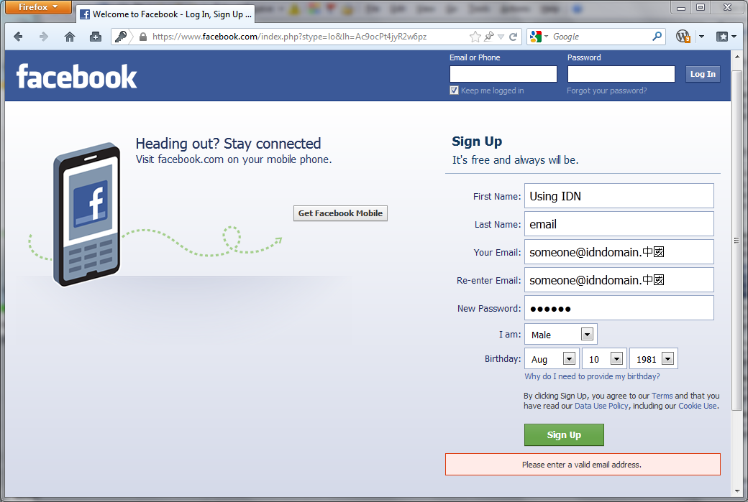

Slide 9
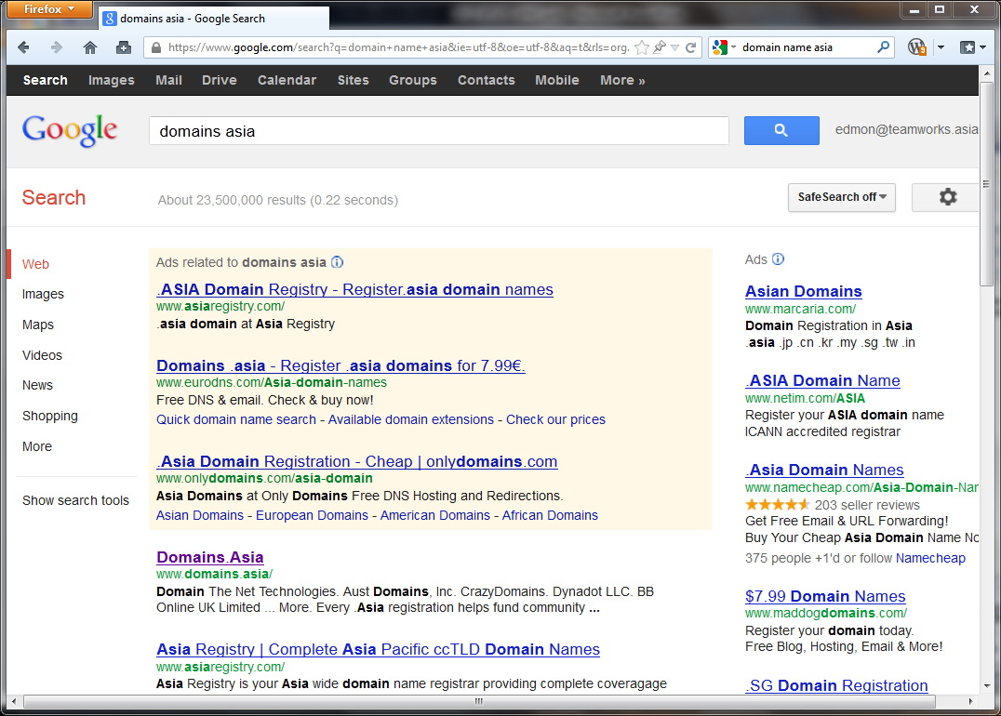

Slide 11
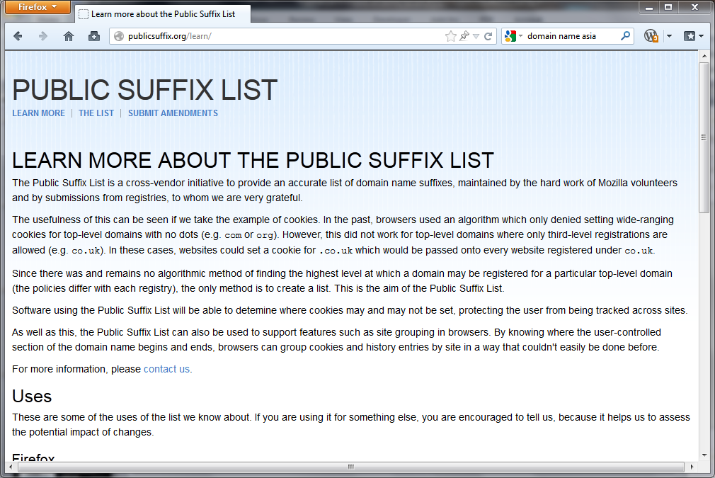

Slide 13
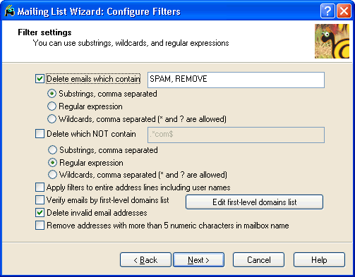
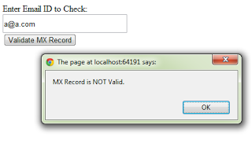

Slide 14
Proposed Recommendations
Recommend IDN TLD operators (including IDN ccTLD, IDN gTLD and IDN gTLD Accredited Registrars) to support Universal Acceptance of IDN TLDs in their own systems
Allocate specific resources for the advocacy of Universal Acceptance beyond the development of informational materials and toolkits
Development of informative reference materials for new IDN TLDs (including gTLD and ccTLD) to handle issues of Universal Acceptance
Direct efforts, lead by staff, with the participation from the community, for further studies to investigate the scope of the issue and what other services or actions could be taken by ICANN to support the Universal Acceptance of IDN TLDs beyond outreach and awareness campaigns

Slide 15
Get Our Own Act Together
Recommendation A

Slide 16
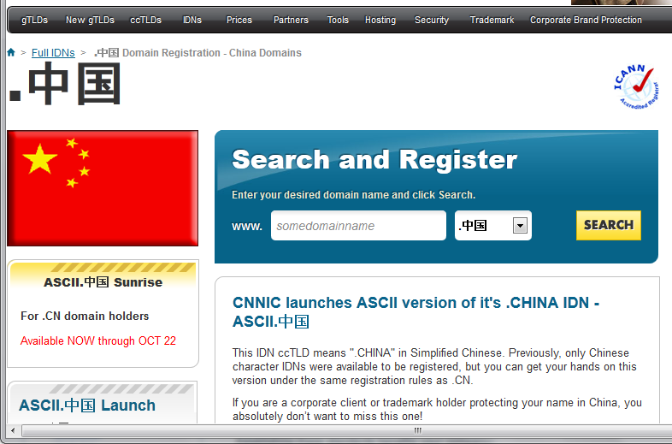
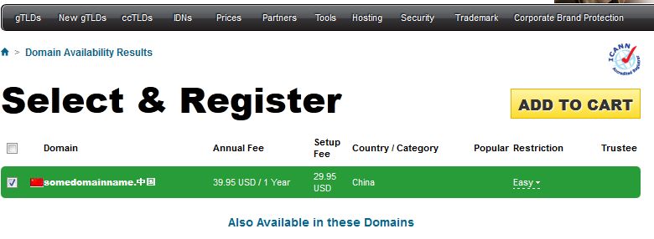

Slide 17
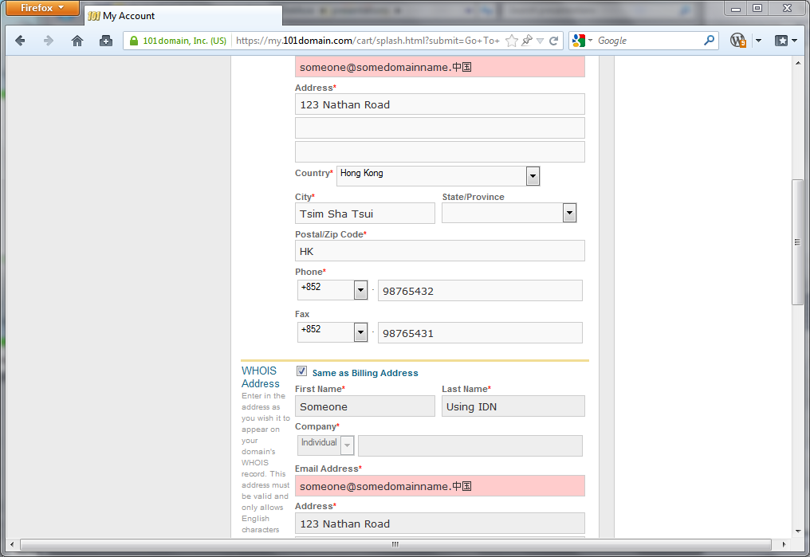

Slide 18
Recommendation A
Recommend IDN TLD operators (including IDN ccTLD, IDN gTLD and IDN gTLD Accredited Registrars) to support Universal Acceptance of IDN TLDs in their own systems
IDN gTLDs and IDN ccTLDs
IDN gTLD Accredited Registrars
Name servers, email addresses, etc.
Proposed Implementation:
Updating of ICANN IDN Guidelines

Slide 19
Identify as a Strategic Initiative for ICANN
Recommendation B

Slide 20
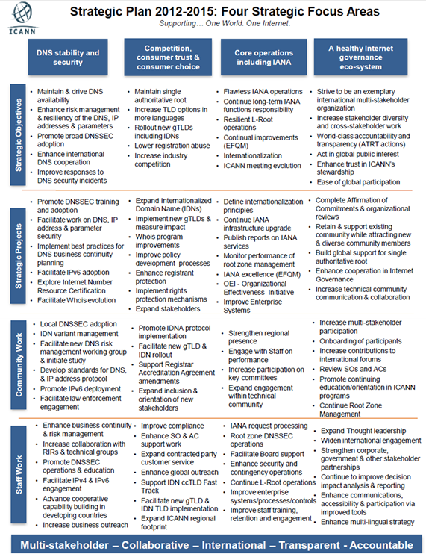
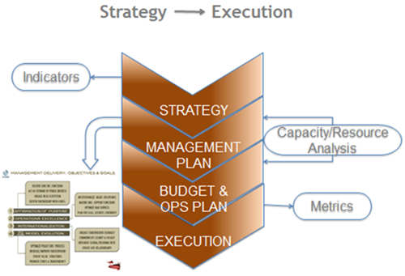
Notes:
Allocate specific resources for the advocacy of Universal Acceptance in budget and in Strategic Plan

Slide 21
Recommendation B
Allocate specific resources for the advocacy of Universal Acceptance beyond the development of informational materials and toolkits
a critical factor to foster and ensure competion, consumer trust and choice in the DNS marketplace
Common interest between gTLDs & ccTLDs
Proposed Implementation:
ICANN board and staff to take into consideration and identify as an item in budget & strategic plan

Slide 22
Support for New IDN TLDs
Recommendation C

Slide 23
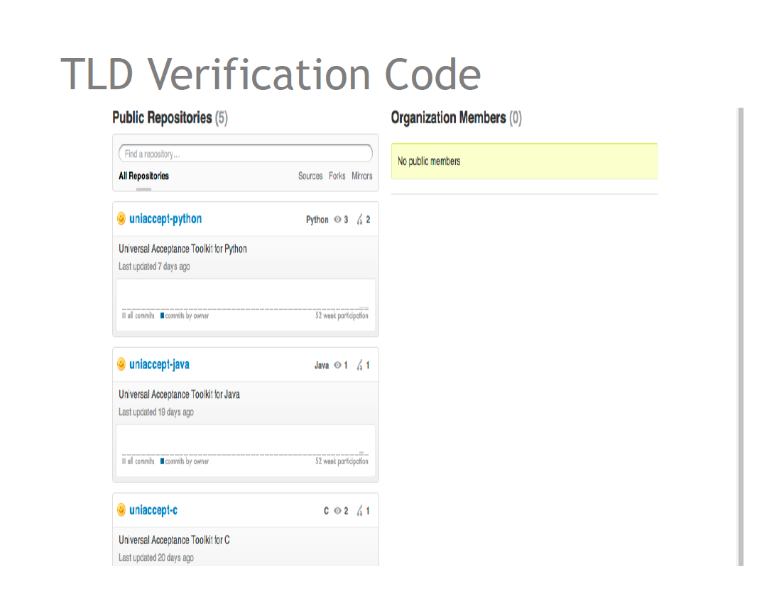

Slide 25
Recommendation C
Development of informative reference materials for new IDN TLDs (including gTLD and ccTLD) to handle issues of Universal Acceptance
draw on and consolidate the experience from earlier launches of TLDs (including gTLDs and ccTLDs) to produce a set of informative reference materials to assist new TLD operators
Proposed Implementation:
Work through Staff Universal TLD Acceptance Team

Slide 26
Beyond Outreach & Awareness
Recommendation D

Slide 27
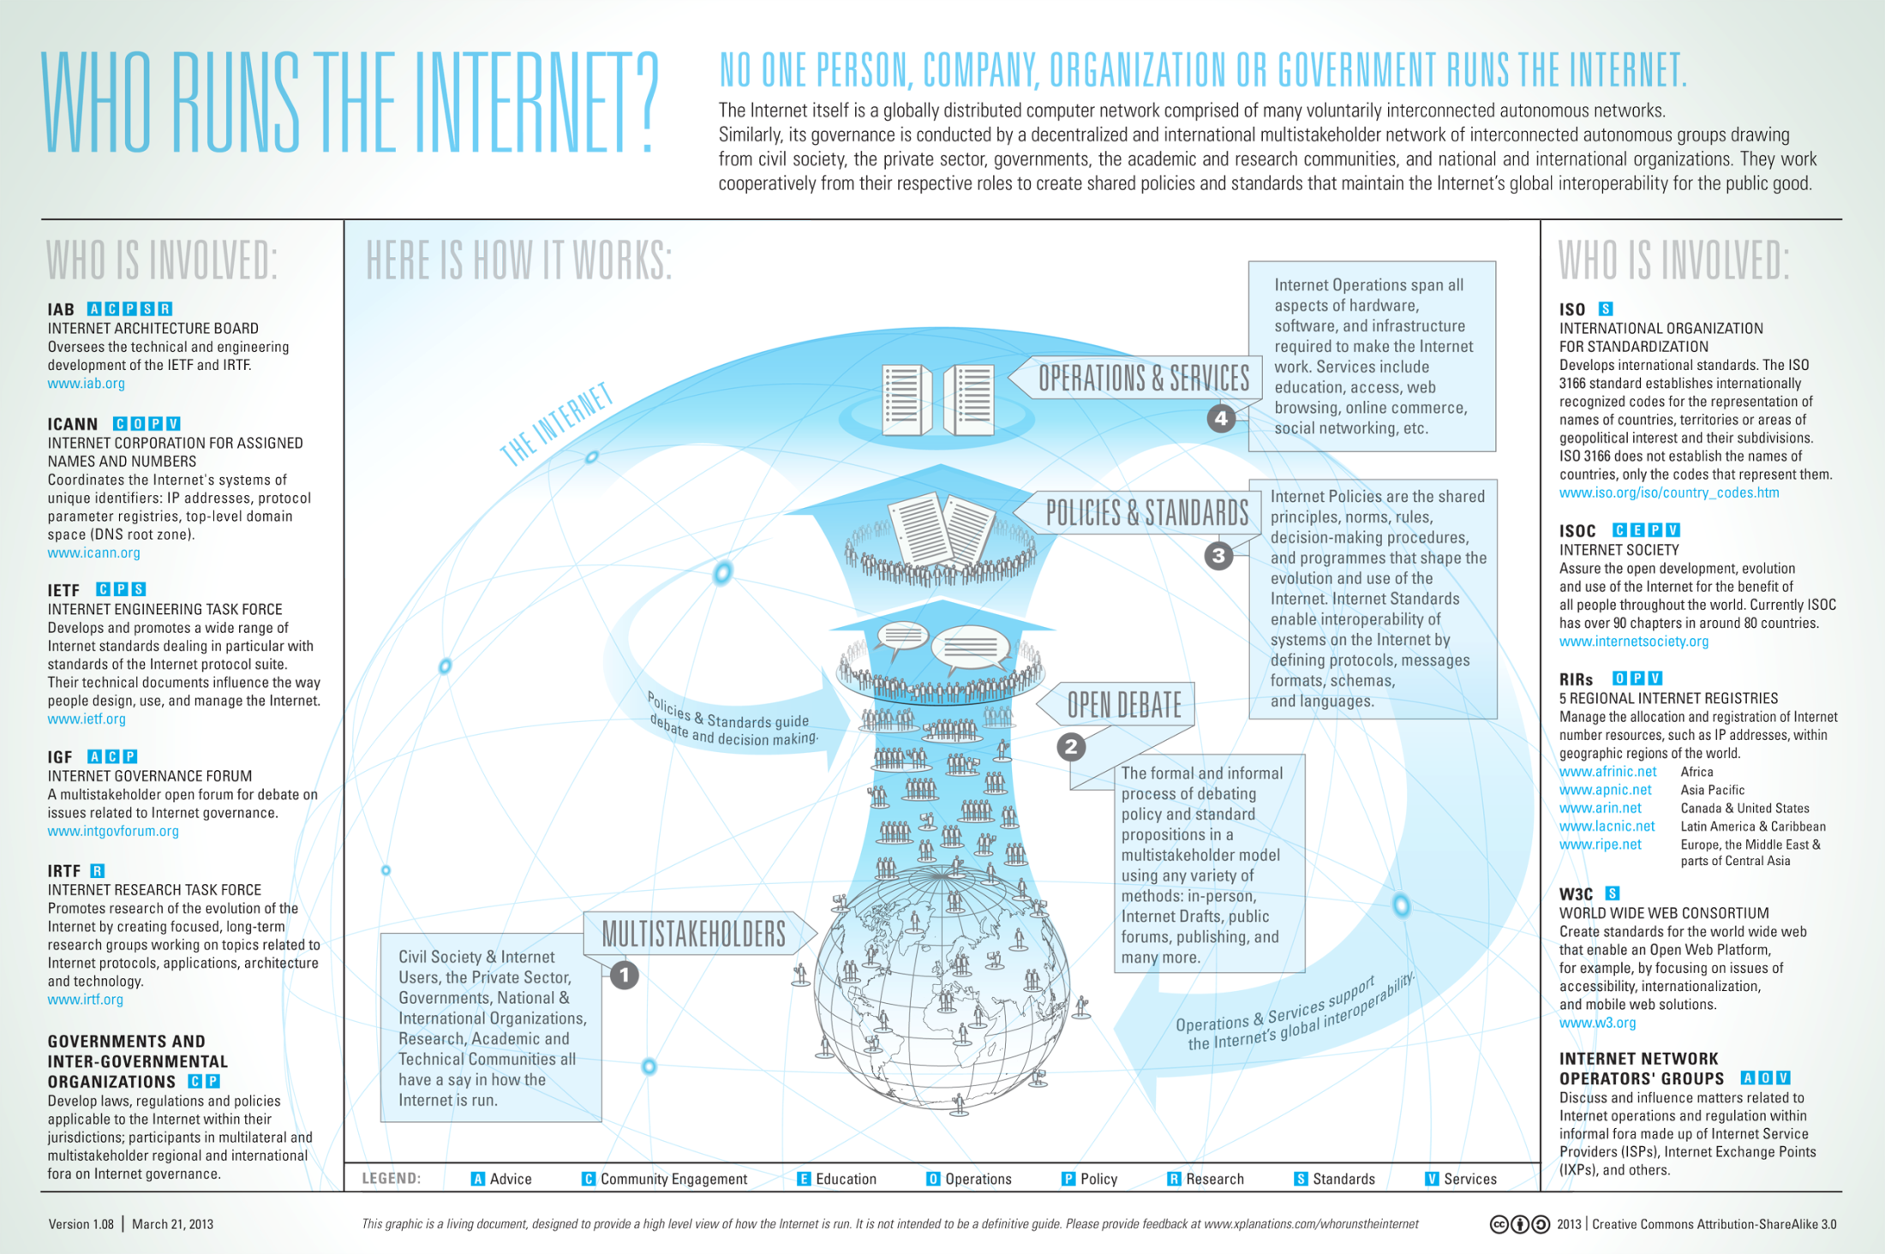
Notes:
Direct efforts, lead by staff, with the participation from the community, for further studies to investigate the scope of the issue and what other services or actions could be taken by ICANN to support the Universal Acceptance of IDN TLDs beyond outreach and awareness campaigns
Engaging with community beyond ICANN
Establishing Liaisons with emerging industry standards
Consider additional services (e.g. 2LDs under TLD)
Proactive Advocacy & Surveys

Slide 28
Recommendation D
Direct efforts, lead by staff, with the participation from the community, for further studies to investigate the scope of the issue and what other services or actions could be taken by ICANN to support the Universal Acceptance of IDN TLDs beyond outreach and awareness campaigns
Engaging with community beyond ICANN
Establishing Liaisons with emerging industry standards
Consider additional services (e.g. 2LDs under TLD)
Proactive Advocacy & Surveys
Proposed Implementation
Through ICANN staff team with support from community

Slide 29
Universal Acceptance Issue will be Amplified

Slide 30
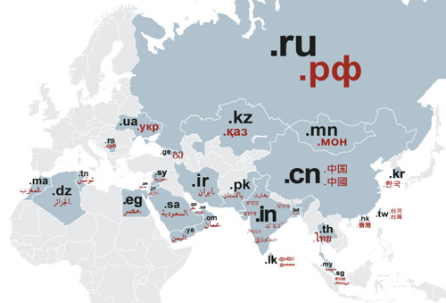

Slide 32
Next Steps
Submit to ccNSO & GNSO Councils for their adoption
Follow up on implementation?

Slide 33
IDN Variant TLDs
Board Resolution 2013.04.11.14

Slide 34
Summary of Response
Implementation of IDN Variant TLDs at the root DNS is not a purely technical matter and requires policy decision and therefore is within the purview of the ccNSO and GNSO;
The ccNSO and GNSO should develop policies for the allocation and delegation of IDN Variant TLDs and continue to monitor its ongoing implementation; and,
Broad-based outreach to the community at-large is important for the success of IDN TLDs, especially with IDN Variants.

Slide 35
ICANN Team Works
VIP Project
IDN Variant TLD Program Projects
Project 2.1: Label Generation Rules
Project 7: Implementation Process

Slide 36
JIG Works?
Policy Implementation and process
Root DB/WHOIS? Delegation requirements?...
EBERO?
Generation Panels
Appropriate set of Experts
GNSO IDN WG Policy Output:
4.1.3. Language Community Input for Evaluation of new IDN gTLD Strings
4.1.4. One String per new IDN gTLD
4.1.5. Limit Variant Confusion and Collision
4.1.6. Limit Confusingly Similar Strings

Slide 37
Single Character IDN TLDs
Any Next Steps?

Slide 38
Aug 25, 2011 Board Resolution
http://www.icann.org/en/minutes/resolutions-25aug11-en.htm#5
Requests specific advice on security & stability aspects of this issue from the SSAC.
Requests the GAC to consider and provide specific advice on public policy aspects of this issue.
Requests specific advice on the end-user/consumer aspects of this issue from ALAC.
Directs the staff to consult with additional appropriate and knowledgeable community participants across various languages/scripts on this topic, and to provide the Board and community a report that reflects this input, to enable consideration by the Board on delegation of single character IDN TLDs.
Directs staff to publish a timetable for this work, clearly indicating that processes for delegation of single-character IDN TLDs will be made available after the first gTLD application round and conclusion of IDN ccTLD policy work.

Slide 39
Current Status (as at Feb 2012)
August 2011 Board Resolution
Response from JIG drafted
Refined by ccNSO Council
Adopted by GNSO Council and ccNSO Councils
Urging Board to provide clearer road map
SSAC Report on Single Character IDN TLDs
Did not uncover any new issues
Reconfirmed that current processes needs to be updated
Suggested additional works

Slide 40
Future of JIG Work
Issues of Common Interest identified:
Single Character IDN TLDs
IDN TLD Variants
Universal Acceptance of IDN TLDs
Next Steps
Following up on Implementation?
Need to adjust charter?

Slide 41
Thank You
Co-Chairs
Young-Eum Li (ccNSO)
yesunhoo@gmail.com
Edmon Chung (GNSO)
edmon@dot.asia

